Slide 1
SEIS 664 Session 00 Course Overview
Charles T. Betz

Slide 2


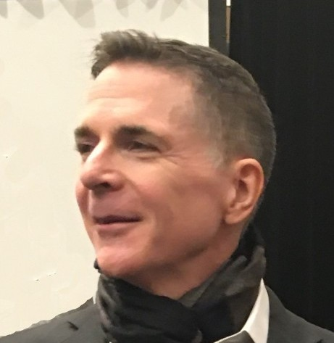


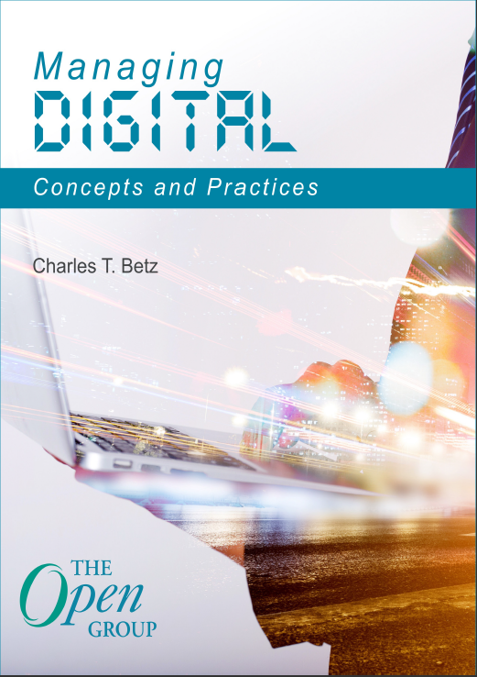
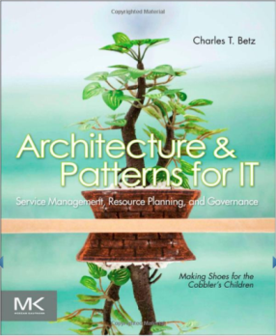

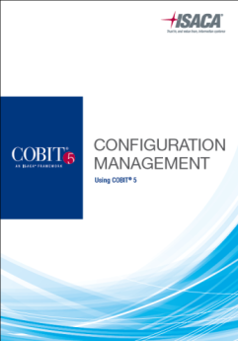
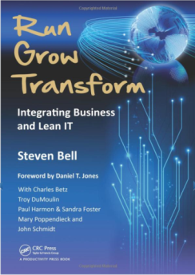
Charlie Betz
www.linkedin.com/in/charlestbetz
@CharlesTBetz
char@lean4it.com
Notes:
bio

Slide 3
Tonight’s agenda
Course overview, logistics, expectations
Summary of curriculum
Technical setup

Slide 4
Course description
This course covers the engineering and operation of IT infrastructure, and related IT management practices in both theory and practice. Students participate in building and operating an end to end “IT supply chain” applying current industrial practices, demonstrating how IT services move from idea through production in a practical industrial setting and are managed and improved over time.
This lab simulation is then used to illuminate key IT management topics such as: Cloud – Virtualization – Infrastructure as code – Web-scale IT – Continuous delivery – Change and incident management – Monitoring and service management – IT process management – IT standards – Continuous improvement for IT.
Students will gain hands-on experience with virtualization, systems administration, DevOps, monitoring, collaboration, and industrial IT processes.

Slide 5
This is a “flipped” class
During the week, you view online lecture and read from
Managing Digital (my book)
Phoenix Project
When you have completed the readings & viewings, you do the quiz, open book but ALONE
If you have someone help you, you will not do well on the in class proctored final!
You are then ready for class
Class is primarily lab and experiential. I keep in class lecture to a minimum. Tonight is the most I will talk.

Slide 6
Expectations
Be here. There is really no way to “make up” these highly experiential classes.
Up to 2 absences are understood and will not be an insurmountable obstacle to a passing grade.
You need to take ownership of any makeup work
Read the syllabus.
It will be updated as the quarter goes on
Bring laptops or be comfortable with class workstations.
Up to 6 hours outside work per week (1:2 standard ratio).
You come from a diverse set of backgrounds
Solving IT problems takes diverse perspectives
Credit will be given for improvement and effort.
Those with more experience will be held to a higher standard.
Finally, we will all be learning. Including me.

Slide 7
Canvas
https://stthomas.instructure.com
You should see this class under “My Courses”
Canvas contains
Syllabus
Attendance
Quizzes
Grades
Assignments
Lecture notes
Links to online resources (GitHub, YouTube)

Slide 8
Required Texts
The Digital Practitioner Body of Knowledge Standard. Available free as PDF and HTML from The Open Group (URL in Canvas)
The Phoenix Project: A Novel about IT, DevOps, and Helping Your Business Win by Gene Kim, George Spafford, Kevin Behr

Slide 9
500 points
Below 325 (65%): F (Ds are not awarded by college policy)
Grading thresholds may be adjusted on the basis of class performance
Attendance and quizzes (190 points, 38%)
5 points per session attended (70 points)
Weekly Blackboard quizzes on reading & videos, 10 points each (120 points)
Complete the week’s quiz online before class ALONE
Quiz will be available at least 1 week in advance
No makeups, because you have all week and can do them remotely.
Do not wait until the last minute and then complain that your personal computer problems prevented you from doing the quiz. There are functioning computers available in the departmental labs.
Come prepared to discuss readings, videos, quiz
Group lab work (180 points, 36%)
Completed team assignments to be submitted as Blackboard assignments
15 points each.
Achieving full credit may require working beyond the course session.
If you are absent, you do not receive lab credit unless you provide independent evidence of having worked through the lab on your own account. I will be overriding your team grade and setting your grade to 0 for the lab. It is your responsibility to ensure I credit you for any offline makeup labs.
Final (130 points, 26%) – multiple choice, true/false, covers entire course
Factors that may severely impact your grade
Significant disregard for assignments, quizzes, and/or labs
More than 2 absences.
A failing grade on the final.
Poor team participation.
EXTRA CREDIT: Make significant, accepted, pull-request-based contributions to course materials on GitHub.
Further instructions for extra credit will be posted to Blackboard.

Slide 10
The quiz
The quiz is a major component of your grade.
It is intended to assess your understanding of the course and keep you on track.
It will include questions from the readings, videos, and labs.
It is always open book, but you need to do it un-assisted
I can’t police this week to week.
BUT the final will be held in class and will consist of similar but not identical questions. So if you rely on others to help you, you will fail the final.

Slide 11
My philosophy re: papers & tests
We rarely write papers in IT, unless you become a senior consultant, analyst, or architect
We usually don’t need to memorize lots of information
We do need a solid understanding of how to find information UNDER PRESSURE, sometimes when no one else is around.
Hence the quizzes and final are individual tests, open book and tightly timed. With a proctored on-site final.
If you try to do them without studying, you WILL FAIL.
Asking anyone else for help is cheating. And you won’t pass the final, because it’s delivered only in classroom.

Slide 12
Grading intent
This class is intended to prepare you for industry in terms of modern Agile IT culture and collaboration
We will chat, swarm, and support each other.
Just like real life, you will be graded on this.
No papers.
In general, real and valuable contributions to
Labs and the Calavera project,
the Architecture of IT Management, and/or
in-class collaboration in terms of supporting your classmates, can result in significant credit.
I get to decide what is “real and valuable.”

Slide 13
A word on the labs
They are always WIP.
Some stuff won’t work
I’ll be embarrassed on a regular basis
We need to swarm & collaborate, make it happen
There is no way I can know more than the union of all the experience you bring and all the learnings you can generate.
This is how it is in the real world too.

Slide 14
Class overview

Slide 15
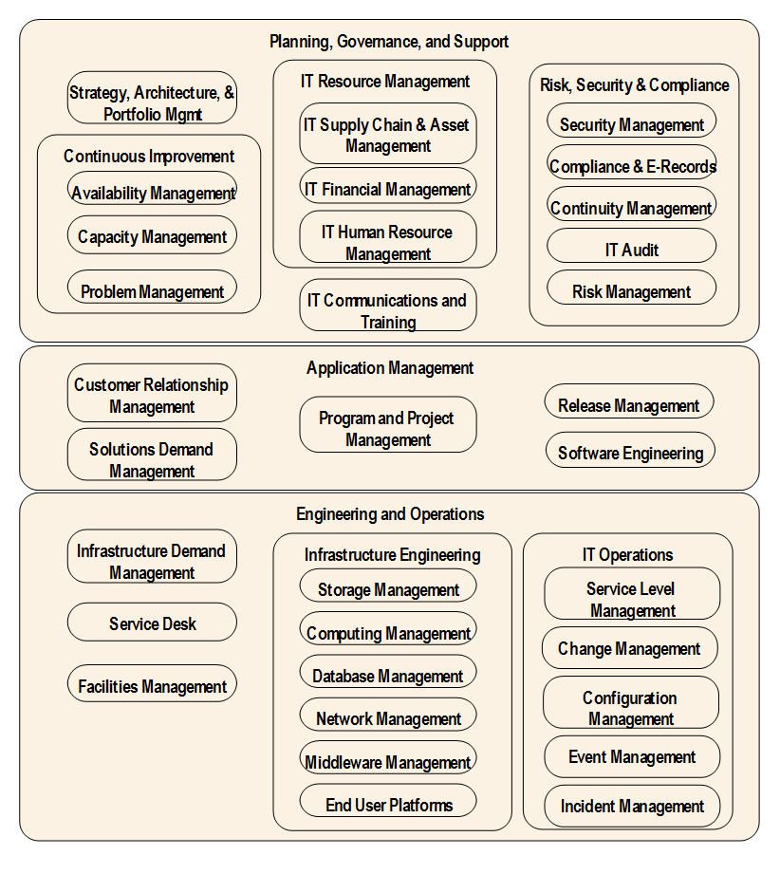
Disciplines in technology management
(combination of ITIL, COBIT & other sources)
GPS course

Slide 16
From startup to enterprise

Slide 17
Course overview
Section I: Inception
IT value
Section II: Collaboration
Product management
Section III: Coordination
Organization& culture
Section IV: Maturation
Governance & security
Information
IT infrastructure
Applications
Work management
Operations management
Architecture
Coordination & process
Investment & project
Weeks 2-4
Weeks 5-7
Weeks 8-10
Weeks 11-13

Slide 18
Section I
Inception

Slide 19
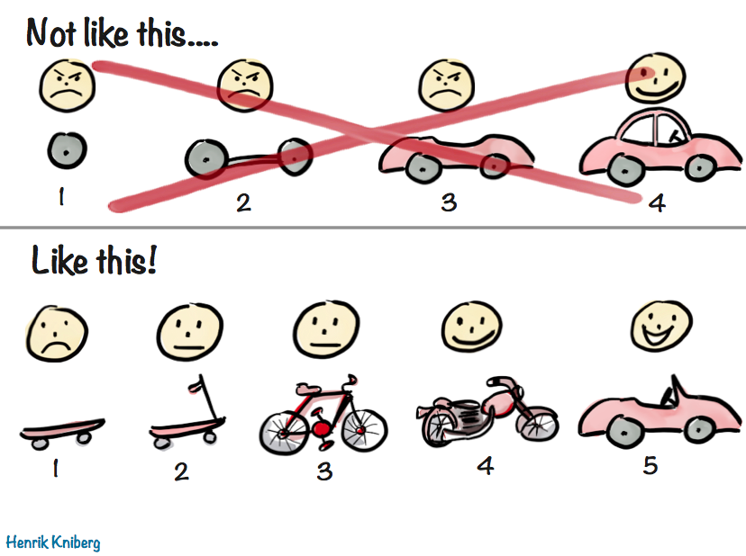
A systems approach
Notes:
The trouble I’ve seen in the guidance, both as a student and now an instructor teaching it at a grad level, is that it’s too much. It assumes enterprise. Here’s how it seems to read – it takes you through a lifecycle at massive scale – you propose, plan, build, and finally run the system, and when you are reading the guidance you experience it the same way. Two dozen processes, or functional components, some related to practices you only see in the largest organizations. Notice that the top is exactly what we have with ITIL, COBIT, TOGAF, and even, yes, IT4IT. Essentially, it’s waterfall. I think this is the fundamental problem of the industry frameworks. Henrik developed this graphic to explain how complex systems are built and evolve, as a sort of visual of John Galls quote we saw on the last slide. And what is more complex than an industry framework on how to manage digital investments and delivery?

Slide 20
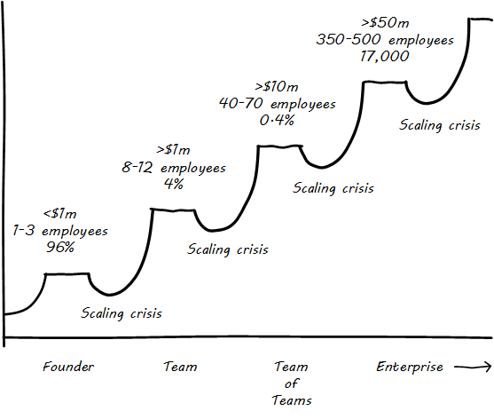
The challenges of scale

Slide 21
A systems approach
Notes:
This is what experiencing and learning industry guidance should feel like. The minimum viable product, the walking skeleton – there are many. You plan/build/run from day 1, but on the smallest fully functional platform you possibly can work with. Policy management? Even project management? Don’t need it.

Slide 22
Course overview
Founder
IT Value
Team
Product
Team of Teams
Coordination
Enterprise
Governance and security
Infrastructure
Applications
Work
Operations
Information
Architecture
Investment
Organization and culture
Weeks 2-4
Weeks 5-7
Weeks 8-10
Weeks 11-13

Slide 23




Founder
Digital Value
Infrastructure
Applications
Notes:
As a founder, you have a very simple operating model. You need some sense of the digital value you are going to offer, what your reason for being is. But once you have that, your concerns are very practical. You don’t have time for advanced operating model concepts like process frameworks or formal risk management. What tools/platforms are you going to use to deliver value? And once you decide on your tools, what is your overall flow of digital value? You don’t have time to formalize much more than that.

Slide 24

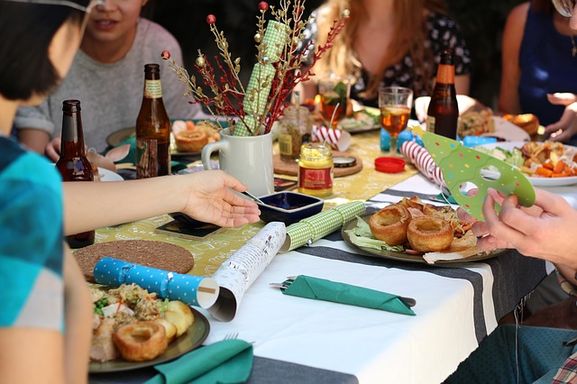

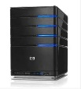
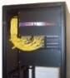
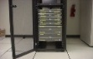
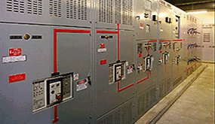
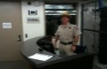

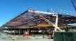
The IT moment of truth
Moment of truth
IT Service
Notes:
IT has been doing Lean since the beginnings
The first programmer who realized how to rewrite an algorithm so it took 50% less processing time – weren’t they doing Lean?
End to end flow across all the elements of the infrastructure – absolutely required. No value otherwise.

Slide 25



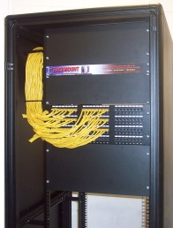
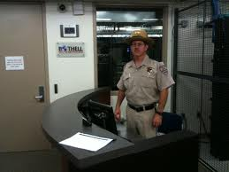
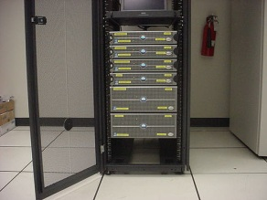
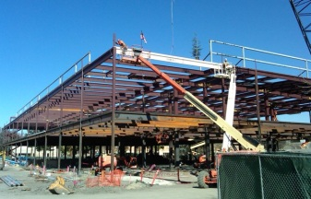
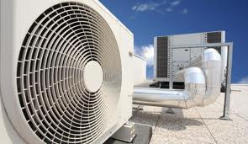
IT infrastructure supports IT value
Can I afford dinner out?
Moment of truth
Application
Platform
OS
Computer
Network
M, E & P
Notes:
Bear with me. This may seem obvious. But it’s important to have a foundation.
Instantaneous value delivery, i.e. a service

Slide 26





The essential states of the IT service
Grant access
(Service request management)
Moment of truth
User support
(Service desk)
IT Service
Throw the switch!
(Change management)
Service restoration
(Incident management)
Construction
Service improvement
(Enhancement, problem management, much more)
The end
Idea
Funding
Notes:
“Inspire to retire”

Slide 27
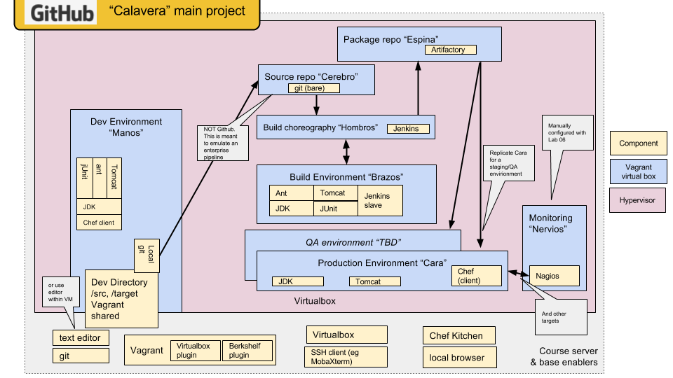
DevOps core

Slide 28
Section II
Collaboration

Slide 29




Team
Product Management
Work Management
Operations
Notes:
Hey, you made it. You’re thinking at the team level. Either your startup succeeded, or you got promoted in your larger organization. Now you have a whole new set of operating model concerns: product, work, and operations.
The team level is the value level, it is where humans come together in close contact and creativity can be maximized … sometimes. A focus on teamwork is central to the Agile movement, you’ll see it all over the place at an Agile Alliance event or in their online materials. It’s so critical in describing a modern BOK that we have this team perspective. The high performing, collaborative team has always been the most valuable asset in the modern enterprise. Everything that comes after, needs to serve. This is fundamentally why process-centric approaches can be so destructive.

Slide 30
Course overview
Section I: Inception
IT value
Section II: Collaboration
Product management
Section IV: Maturation
Governance & security
Information
IT infrastructure
Applications
Work management
Operations management
Architecture
Section III: Coordination
Coordination
Execution & planning
Organization& culture
Weeks 2-4
Weeks 5-7
Weeks 8-10
Weeks 11-13

Slide 31
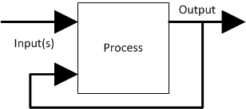
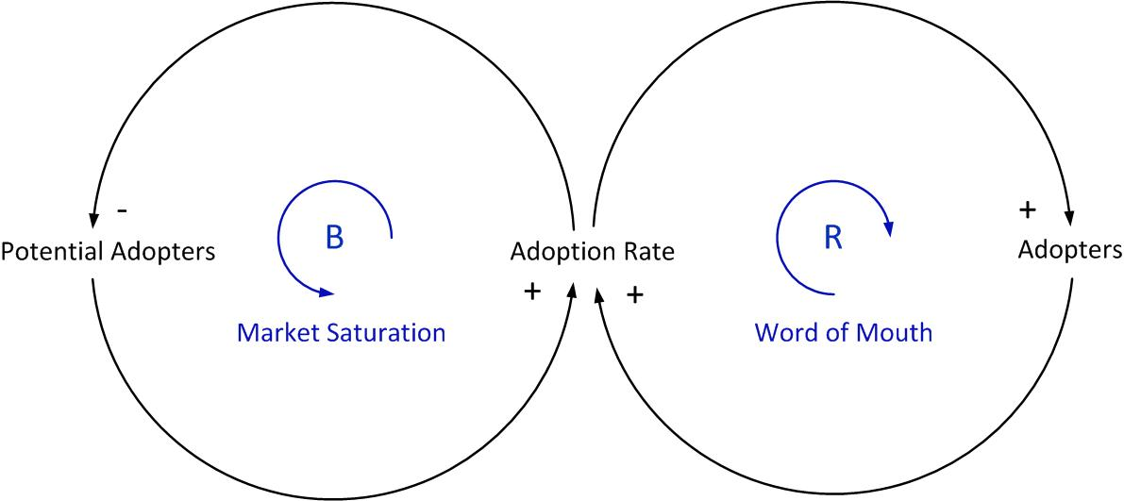
Feedback & systems theory

Slide 32
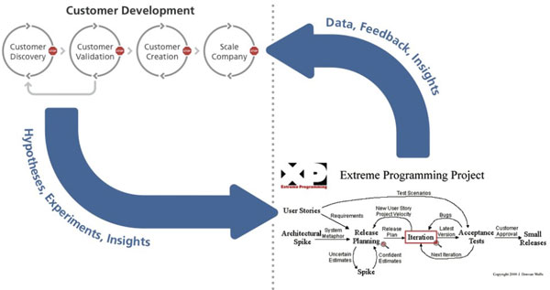
Product management
http://practicetrumpstheory.com/achieving-flow-in-a-lean-startup/

Slide 33
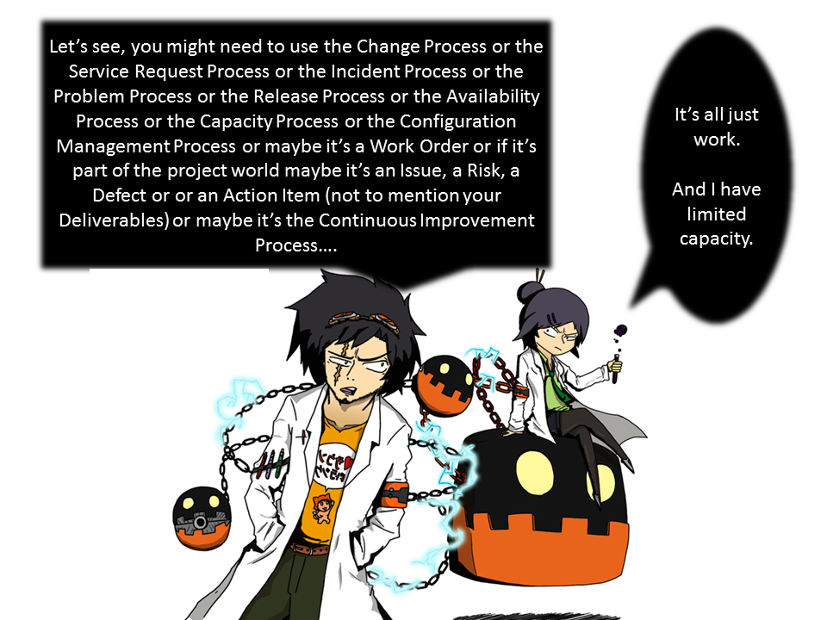
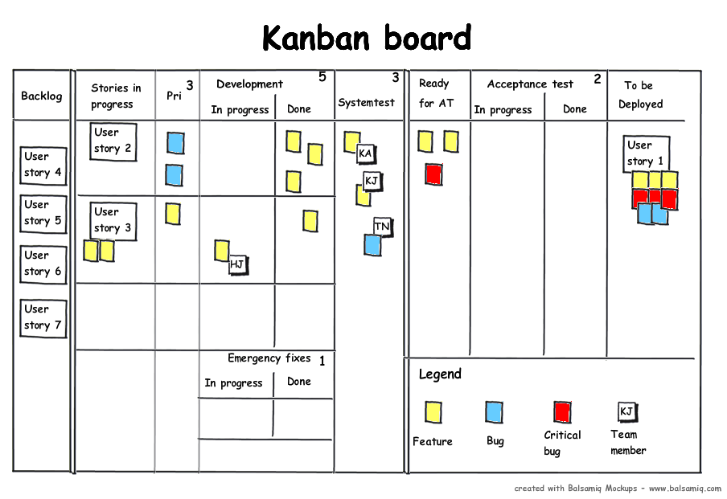
Work management

Slide 34
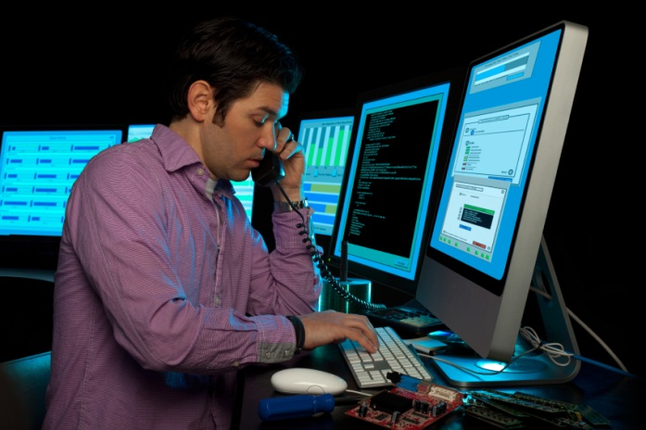
Operations management

Slide 35
Section III
Coordination

Slide 36
Course overview
Section I: Inception
IT value
Section II: Collaboration
Product management
Section IV: Maturation
Governance & security
Information
IT infrastructure
Applications
Work management
Operations management
Architecture
Section III: Coordination
Coordination
Execution & planning
Organization& culture
Weeks 2-4
Weeks 5-7
Weeks 8-10
Weeks 11-13

Slide 37





Team of teams
Culture & Organization
Investment
Coordination
Protect team
level delivery!
Notes:
Now we hit the big ugly. The transition from “team” to “team of teams.” The challenge here is protecting team level delivery, while dealing with multiple teams that have some form of dependency. It’s a Wicked Problem and you should be very wary of anyone selling magic beans here, whether project management, process management, scrum of scrums, or Scaled Agile Framework. The best I can see is that there are a variety of tools and practices that, depending on your situation, might help. All of them have pros and cons.
Coordination, communication, signalling, marshalling… minimize...

Slide 38
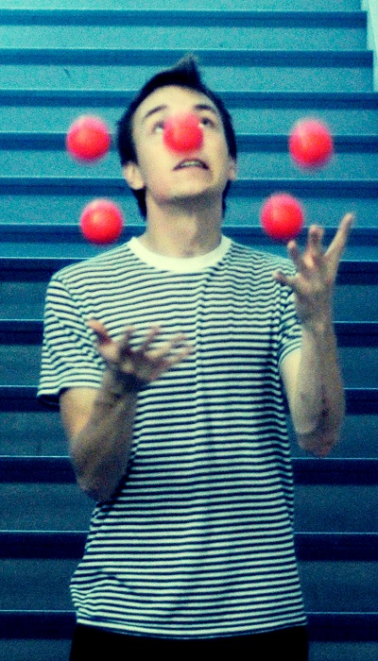

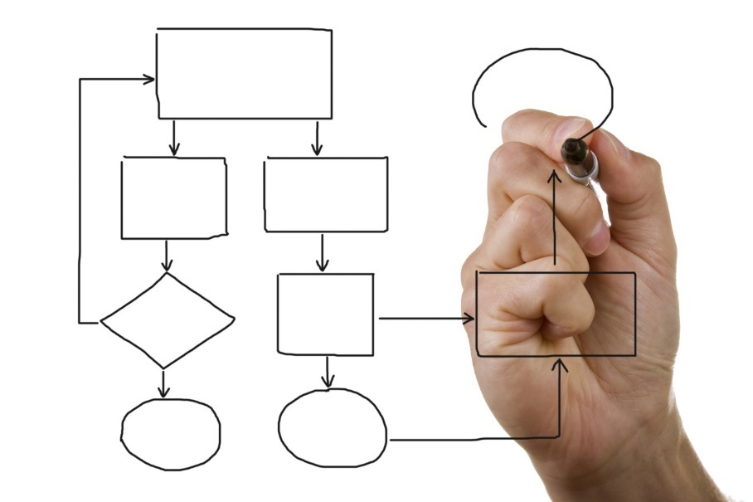
Coordination

Slide 39
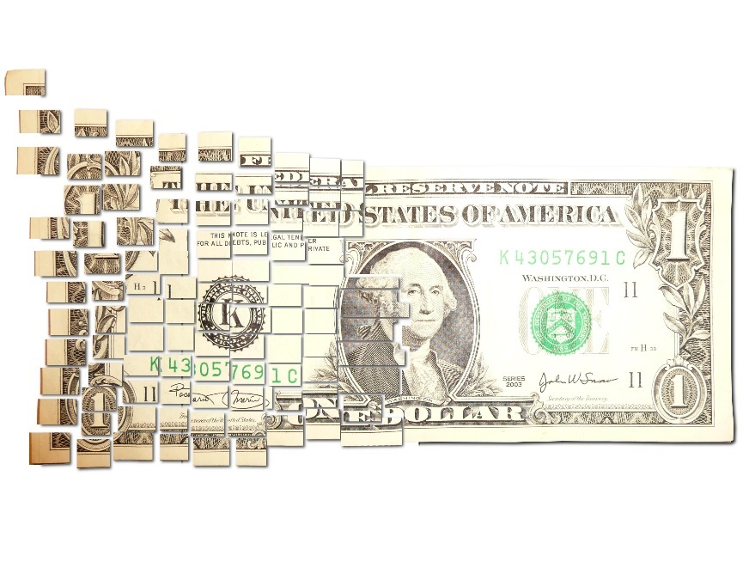
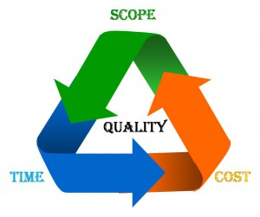
Investment and planning

Slide 40

Organization & culture
CEO
Sales & Marketing
R&D
Operations
CIO
Legal
CFO
How we do things around here…

Slide 41
Section IV
Maturation

Slide 42
Course overview
Section I: Inception
IT value
Section II: Collaboration
Product management
Section IV: Maturation
Governance & security
Information
IT infrastructure
Applications
Work management
Operations management
Architecture
Section III: Coordination
Coordination
Execution & planning
Organization& culture
Weeks 2-4
Weeks 5-7
Weeks 8-10
Weeks 11-13

Slide 43




Enterprise
Governance & Security
Information
Architecture
Notes:
Finally, you’ve hit the Enterprise level. I’m going to reiterate that this discussion of operating models is based on what you formalize as a capability. You’ve been thinking about security, governance, information, and architecture all along. But now you need to formalize them. You’re now highly conscious of the external forces acting on you, from hackers to regulators to auditors, and you can’t rely just on tactical, fire-fighting responses. You need things like Enterprise Risk Management, policies, architecture standards, and so forth – they are not optional for enterprises. However, there are promising approaches for handling such requirements in new ways, in the digital operating model of the future. For example, Gene and Jim Deluccia wrote the DevOps Audit Defense Toolkit, very useful piece of work.

Slide 44
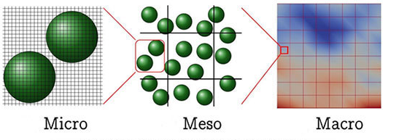
Scale

Slide 45
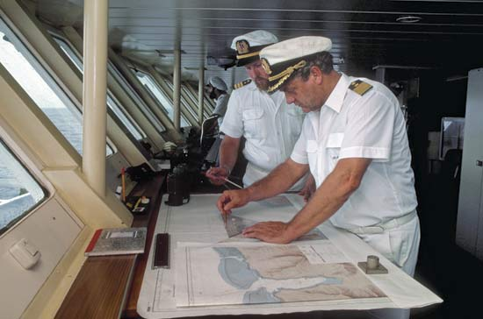
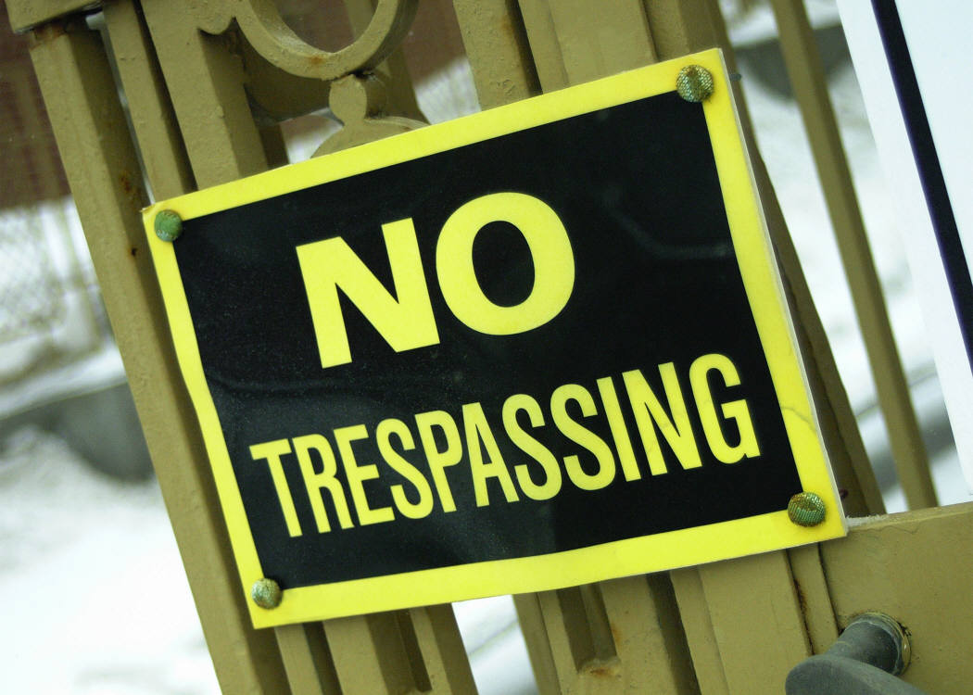
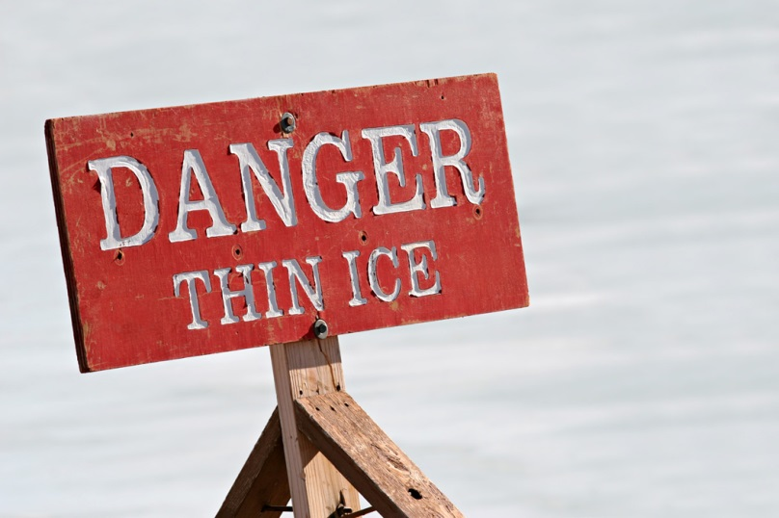
Governance, risk, security, and compliance

Slide 46


Enterprise information management

Slide 47
Analytics
Business performance
User perception
Security Breaches
Data quality
Sponsor perception
Inputs
Sponsor wilingness to pay!
Constraints & rework
Lifecycle value
Execution & delivery
Notes:
The data is available. Very few organizations integrate it. Requires combining IT operations with business performance. IT as just another functional area.

Slide 48
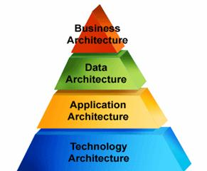
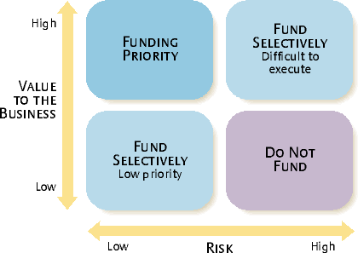
Architecture and portfolio

Slide 49
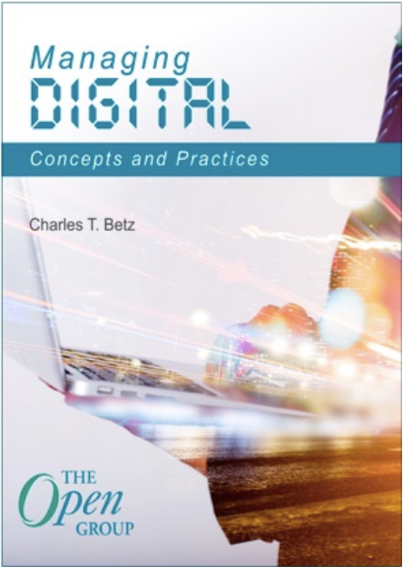
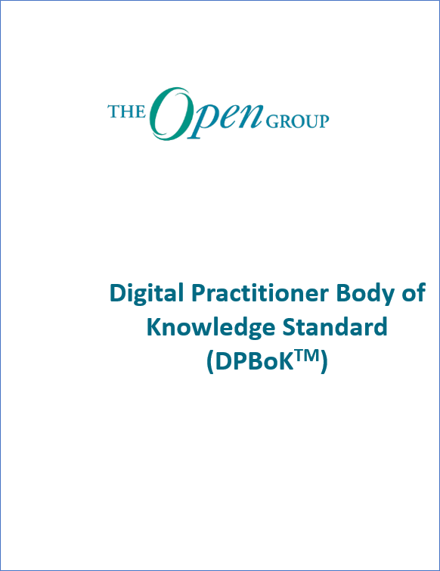
Converting Managing Digital into a standard
Notes:
Incorporating much of the source text for the working draft of the DPBoK, over the past year, the DPWG has simplified, edited, and added the necessary components to make the DPBoK into the first body of knowledge and standard for Digital Practitioners!
Naturally, The Open Group also employed its ‘Company Review Process’ which also incorporated review and feedback from organizations and individuals from across different industries.
[next slide]

Slide 50
Break

Slide 51
Introductions and 2-person team formation
Line up by experience
Pair off tailwise
3 in the middle if odd #

Slide 52
Lab 00: technical
This is a hands on class.
You don’t need any experience.
First step:
Canvas collaboration
Terminal emulation
ssh and X-windows access to the server

Slide 53

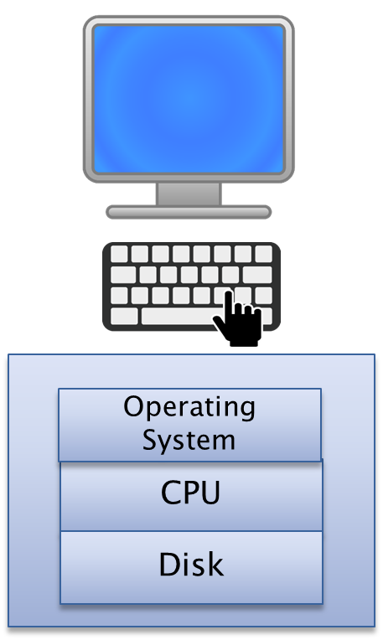

Single vs multi user
User1
User2
User3
User4
User1 resources
User2 resources
User3 resources
User4 resources
Operating System
CPU
Operating System
CPU
Disk
Disk

Slide 54
Challenge vs SSH
Login (putty/ssh)
Server
Who are you?
<name>
What’s the password?
<password>
OK

Slide 55
Challenge vs SSH
Login (putty/ssh)
Server
I see you have a private key consistent with your public key in your directory. Welcome.
.ssh dir
rsa_id.pub
.ssh dir
rsa_id

Slide 56
internet
Your mac
Server1
Server2
Your pc
PC
PC

Slide 57

Your PC
Docker
App
Port mapping
(some web page)

Slide 58

Be sure to check X in putty
ssh –YC on the mac
ssh –YC to server 2 for X traffic
Your PC
Server 1
Server 2
SSH text
curl
Docker
SSH xwindows
App
Port mapping
(some web page)

Slide 59
Github
Pull request
Dm-academy/example
you/example
XXX
YYY
Fork
Clone
you/example
XXX

Slide 60
Seis664-01
VM 1
VM 2
VM
Swarm1
Container
Container
Container
Swarm2
Container
Container
Container
Container
Container
Docker machine
Docker machine
Docker
Docker

Slide 61
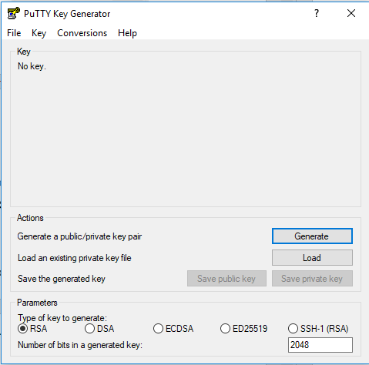

Slide 62
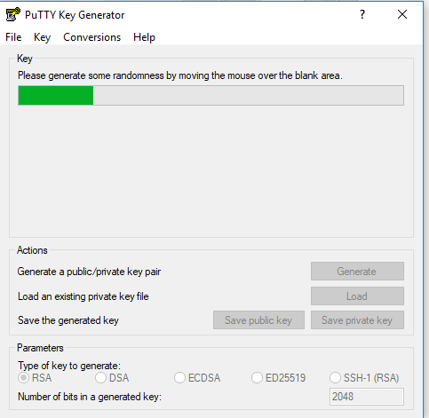
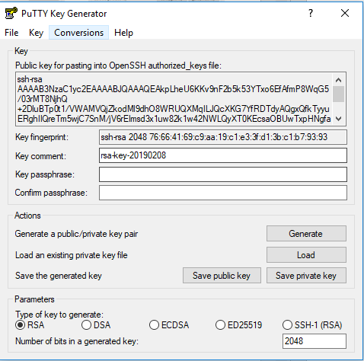

Slide 63
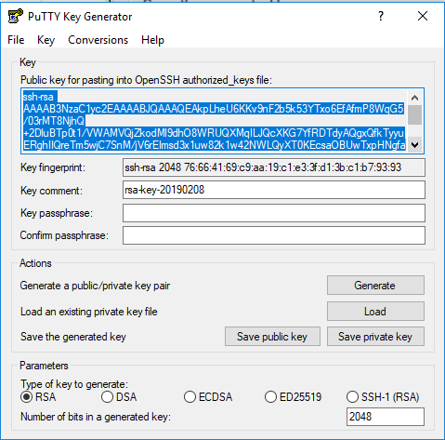
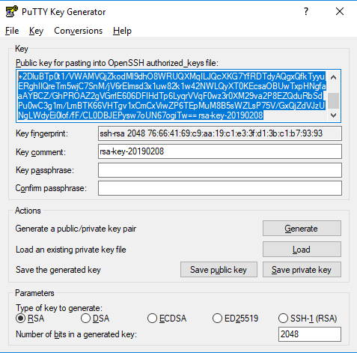
Scroll box up
Scroll box down

Slide 64
seis664-01.gps.stthomas.edu
Ag1l15t!
For git bash:
Try
eval `ssh-agent`
ssh-add
Lower case “L”

Slide 65
Additional material

